Slide 1


WE CONNECT
STUDENT WITH CITY

Slide 2
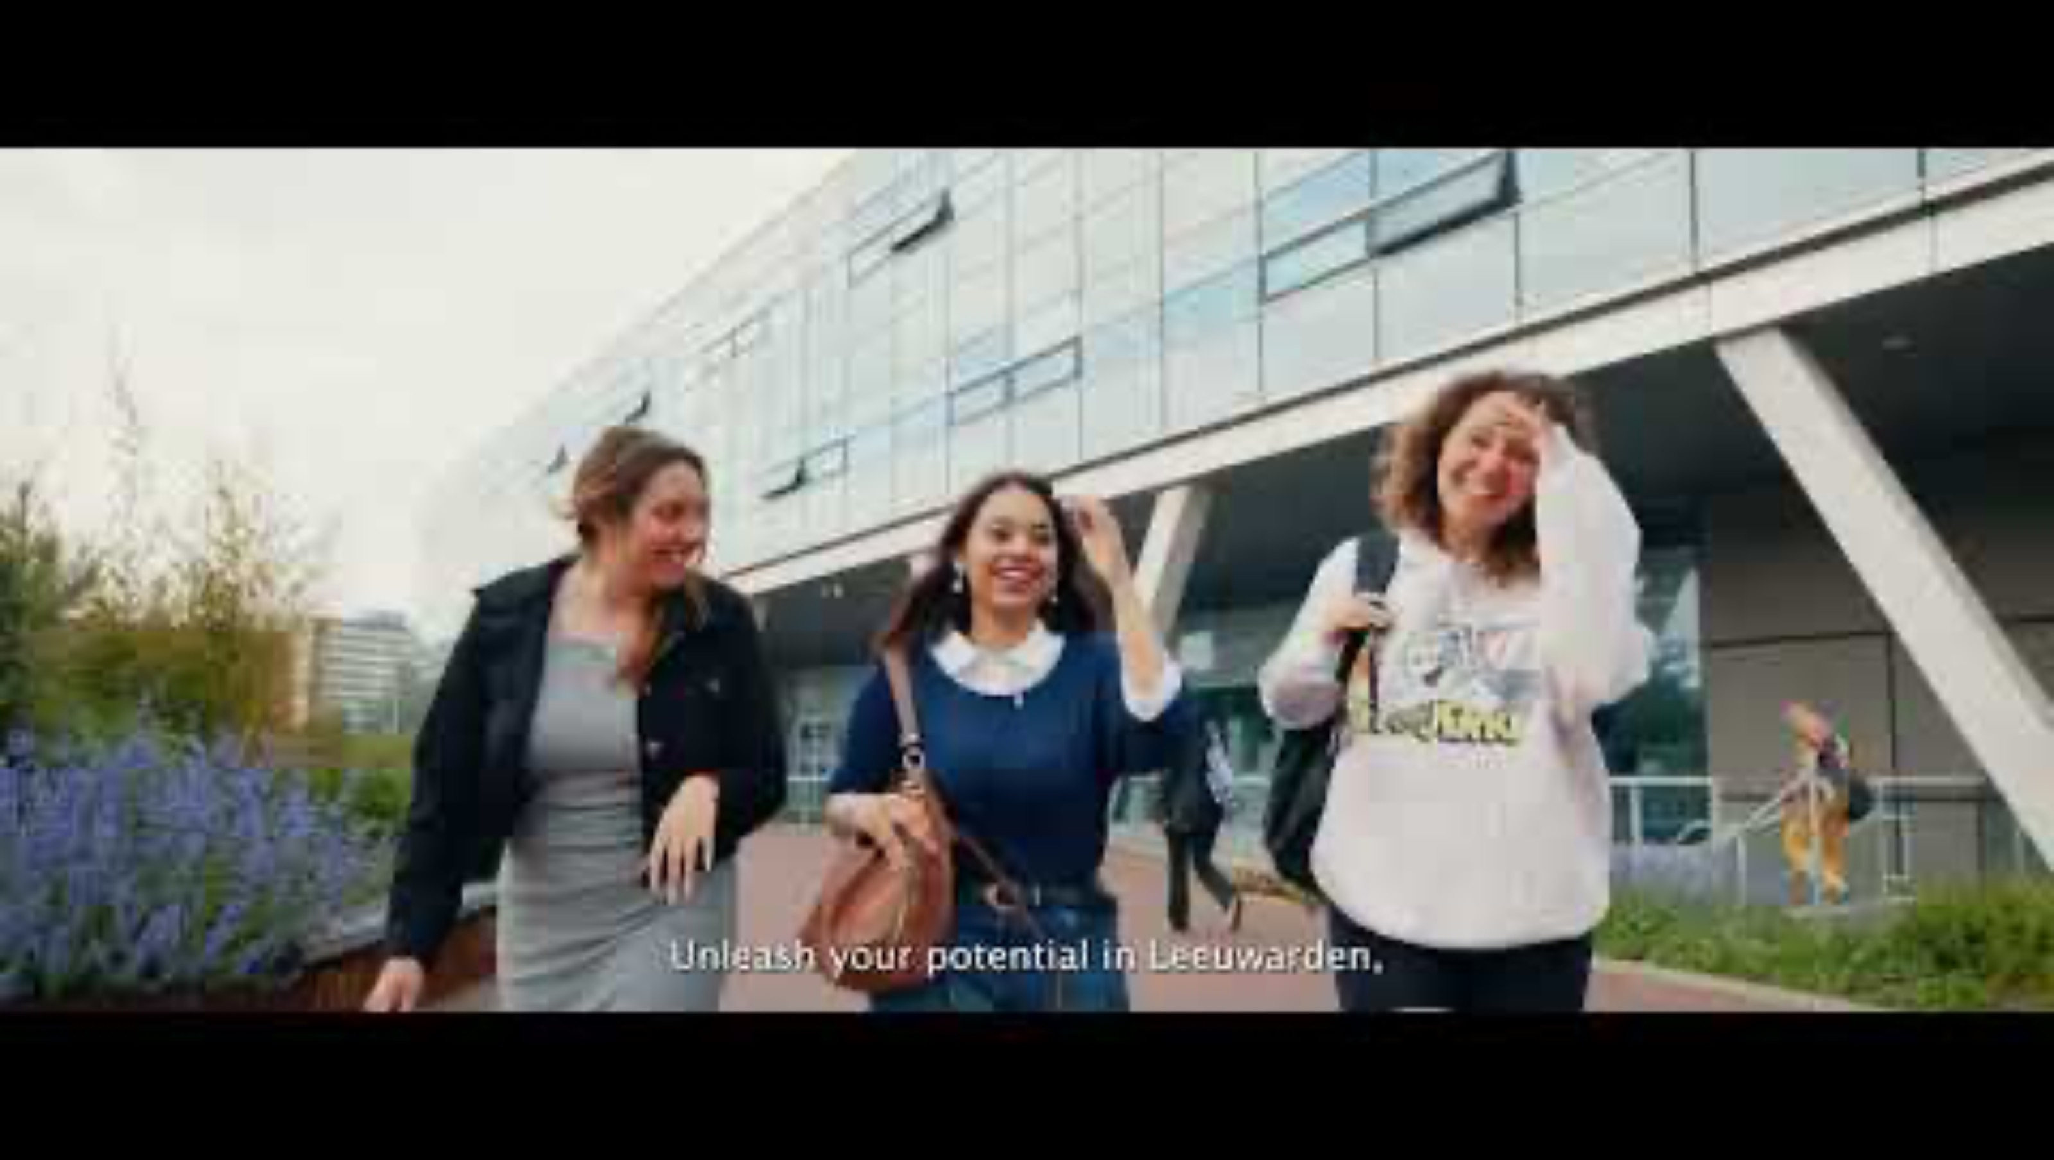

Slide 3

Leeuwarden Student City makes Leeuwarden the ultimate city for students; a place where students feel at home and where future students are eager to go.
Leeuwarden is the place where students choose their own path, find the peace to grow, seek out the hustle to express themselves, find company in diverse activities, and stay healthy by (together) engaging in sports. This is what Leeuwarden Student City stands for. It is what we represent, what we strive for, and what we are committed to achieving.
We do this by activating various parties and being the connecting link between students and the world beyond. Together, we ensure that students enjoy studying in Leeuwarden and perhaps even decide to stay and live here.

Slide 4
CORE VALUES
> CONNECTOR
> INDEPENDENT
> KNOWLEDGE
> TOGETHER
> ENERGETIC
Notes:
CONNECTOR
LSC is the connector, the driving force. We are the party that links all the organizations needed to make Leeuwarden the ultimate city for (future) students. This is the core focus of LSC.
INDEPENDENT
At LSC, the interests and well-being of the student come first. We can guarantee this because we are independent. We represent the students' interests, always with the goal of making (future) students feel at home in Leeuwarden. The image of the Lion symbolizes this independence, as well as the courage to stand for what LSC represents.
KNOWLEDGE
We are at the center of it all. We stay well-informed and listen closely to our network. This allows us to provide students and stakeholders with valuable information and knowledge about students and their world.
TOGETHER
Together, we can make Leeuwarden the student city where everyone feels welcome. We achieve this by collaborating with schools, entrepreneurs, the government, and all necessary stakeholders. Equally important is our cooperation with the students themselves. We work with, for, and especially alongside students.
ENERGETIC
We are active, organizing many events, and are highly visible. We gain energy from working with and for students. Let us handle it—we are the central hub, coordinating with all parties. This gives us energy, allowing us to deliver the best for students with genuine enthusiasm.

Slide 5
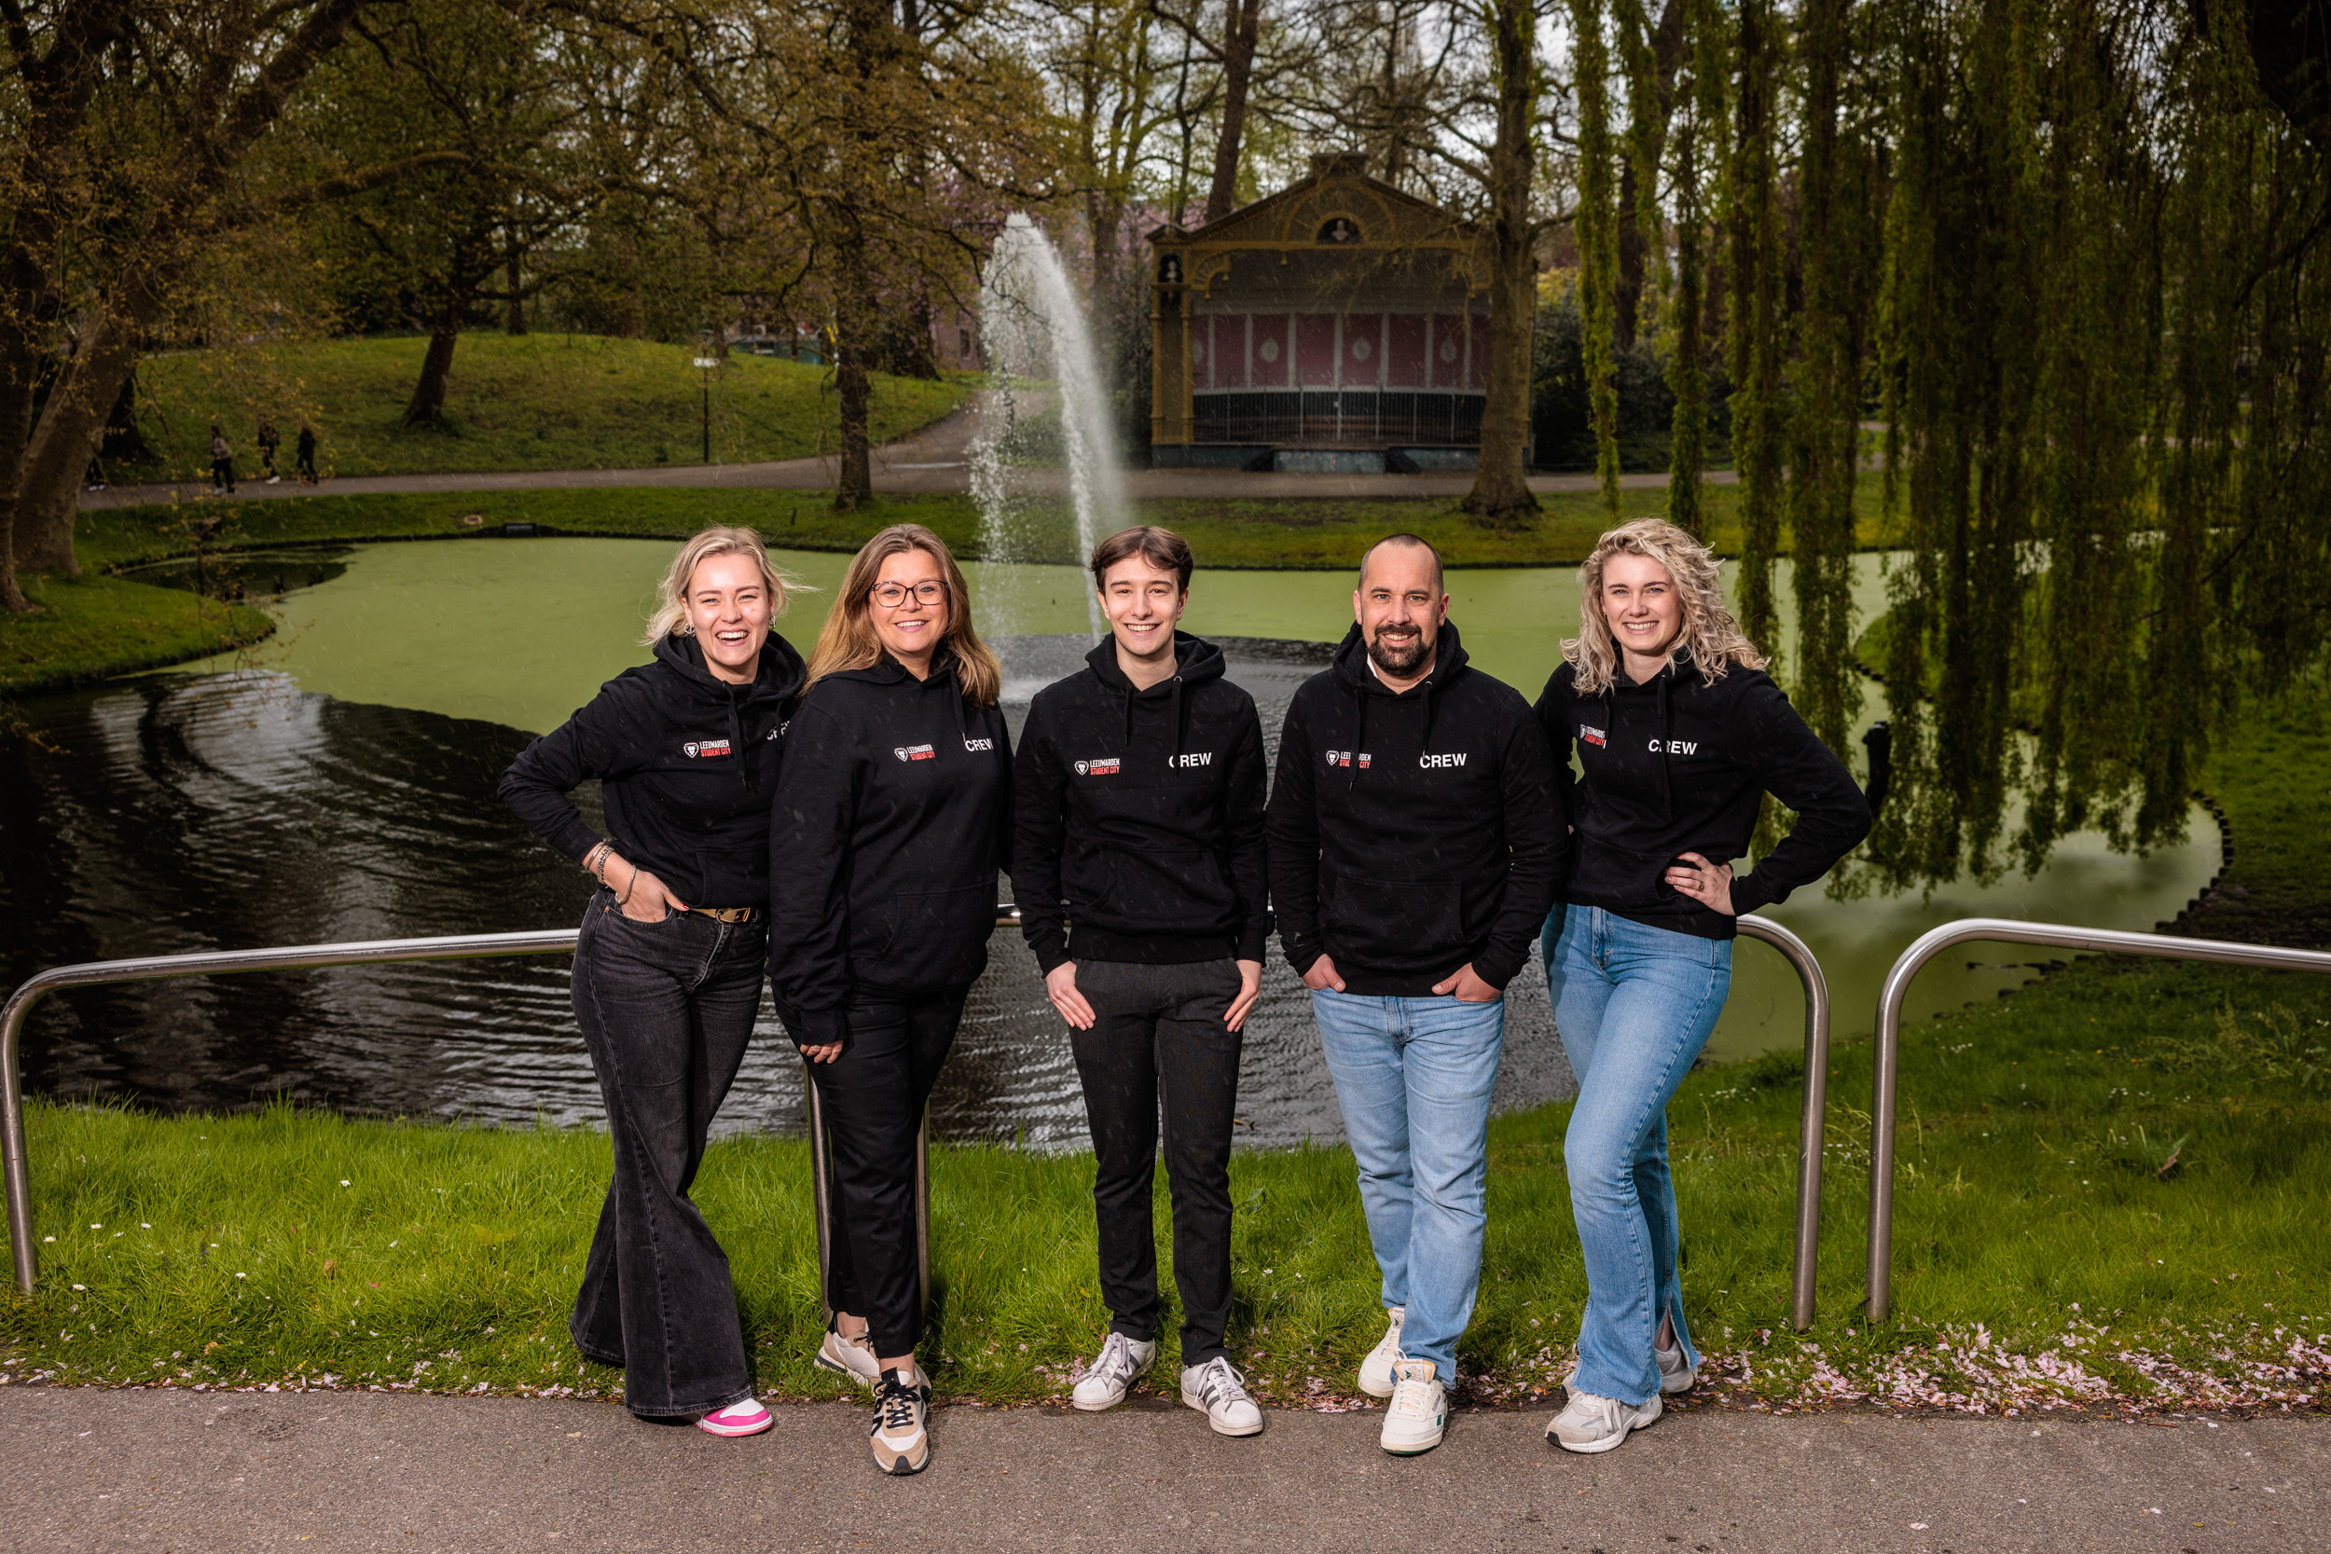
Anton van der sluis
ANNA ROOS
EVENT SPECIALIST
PASCAL
SPORT COORDINATOR
LIANNE
MARKETING
SUSANNE
OFFICE MANAGER
ANTON
DIRECTOR

Slide 6





ORGANIZED as:
> Fiscal unity with NHL Stenden
> Strategic partner with other institutes
> Local government funding
PROVEN by:
> Annual Plan
> Annual Report
> Annual Financial statement
Notes:
“LSC forms a fiscal unity with NHL Stenden, allowing LSC to make use of NHL Stenden’s services exempt from VAT.”
“LSC and NHL Stenden have formed a fiscal unity for VAT purposes, which allows LSC to use services provided by NHL Stenden without being charged VAT. This internal VAT group arrangement ensures that services exchanged within the group are not subject to VAT, in accordance with Dutch tax regulations.”

Slide 7





Slide 8


FIT AND FOCUSED?
WE HAVE EVERYTHING YOU NEED.
YOU JUST NEED TO TAKE ACTION.
TOGETHER, WE'LL MAKE IT HAPPEN.

Slide 9




Slide 10
Badminton, Ballet, Basketball, Beach Volleyball, Bootcamp, BBB/Bootycore, Bouldering, Boxing, Canoeing, Curling, Dancing, Diving, Dodgeball, Fitness & Group Classes, Futsal, Golf, Handball, Hip Hop, High Intensity Training (HIT), Ice Skating, Inline Skating, Karate, Kickboxing, Korfball, Outdoor Fitness, Padel, Pilates, Pitch & Putt, Rock & Roll Dancing, Rowing, Rugby, Self-Defence, Football (Soccer), Spinning, Stand-up Paddleboarding (SUP), Survival Run, Swimming, Table Tennis, Tennis, Volleyball, Yoga.

Slide 11


Slide 12
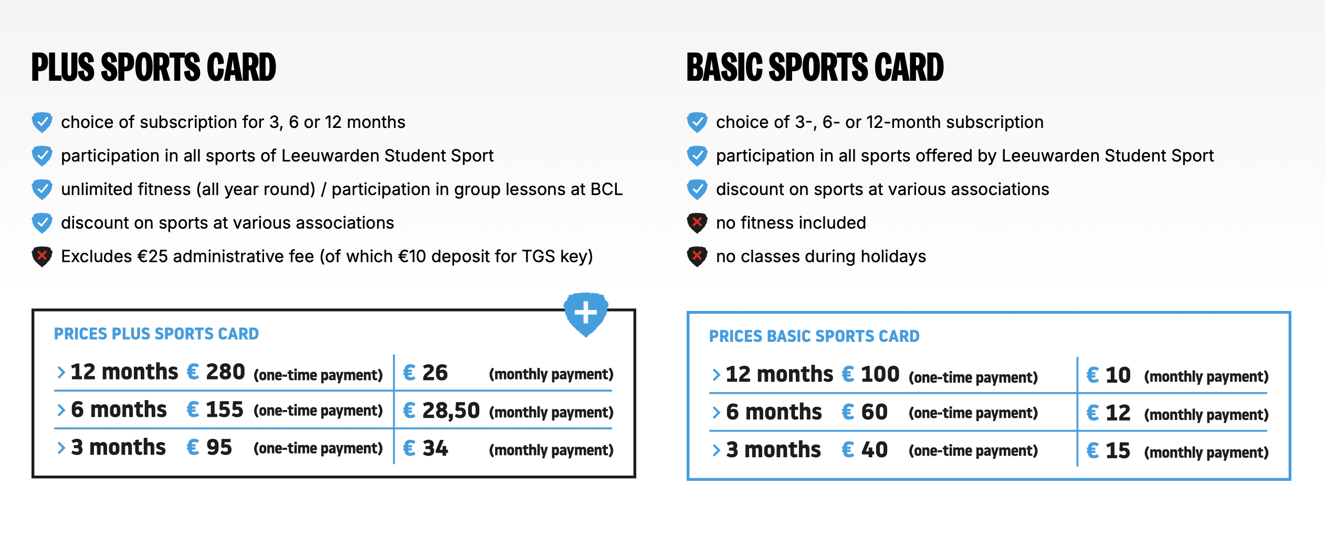

Slide 13
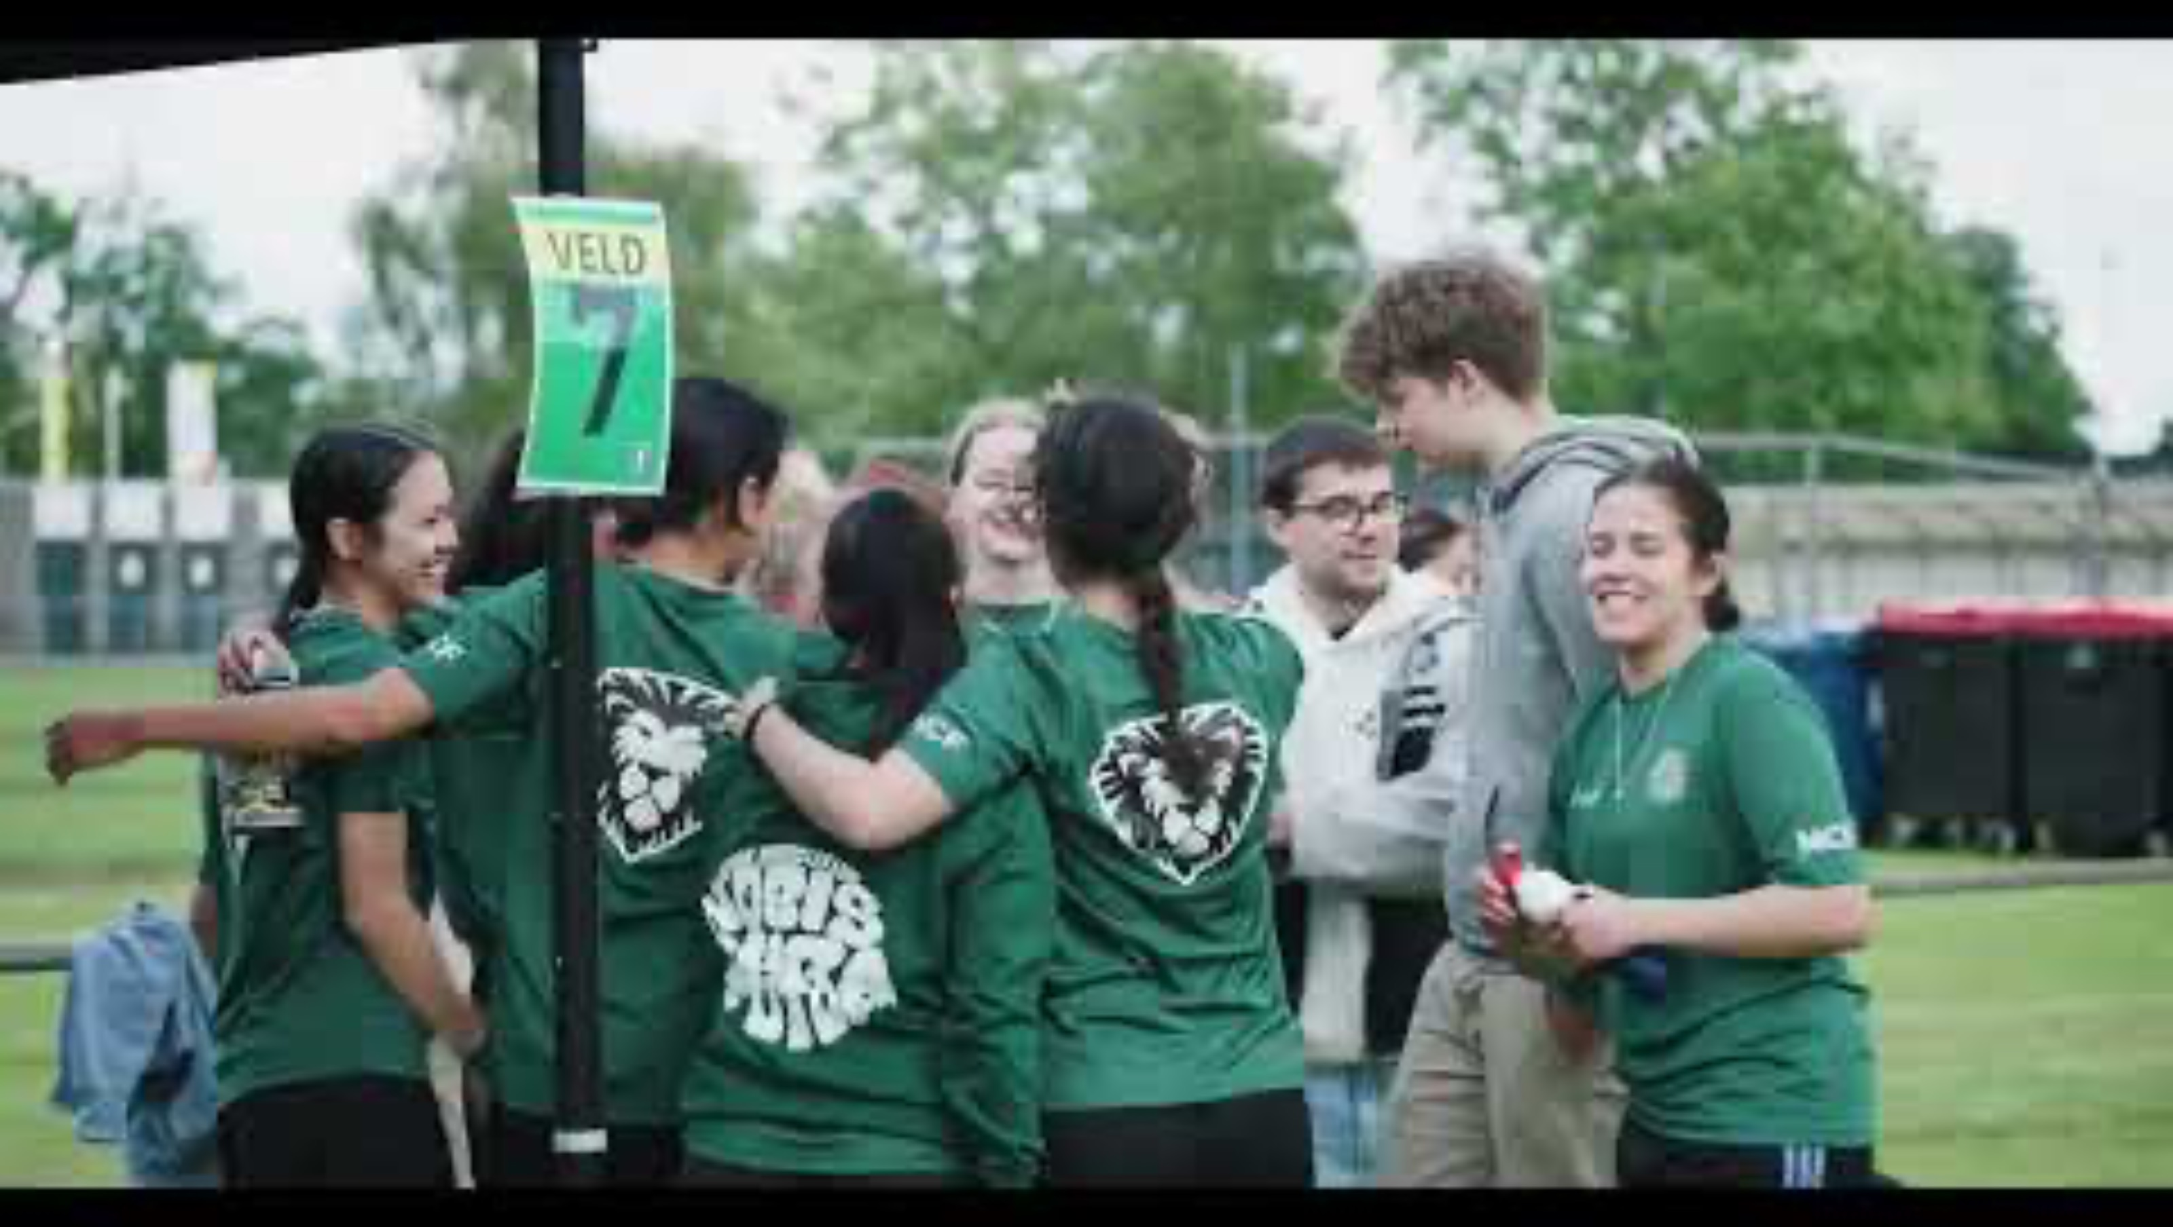

Slide 14
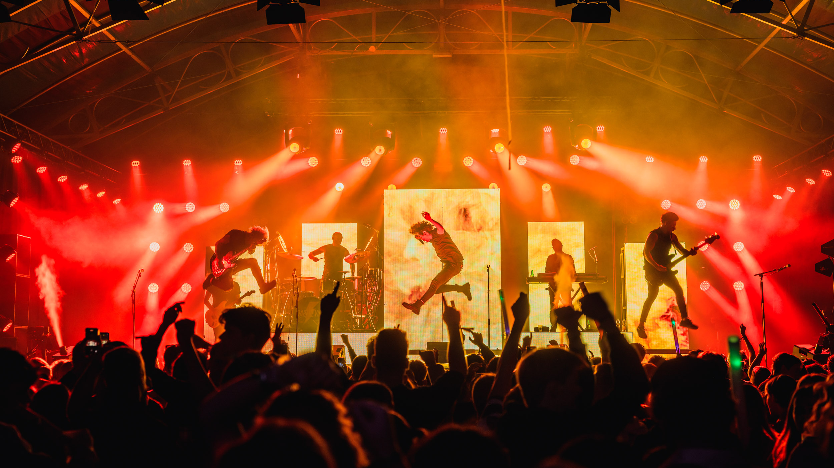
Notes:
LEIP Intro Gedurende de introductiedagen maak je kennis met alles wat Leeuwarden te bieden heeft op het gebied van uitgaan, sport, muziek, eten en drinken. Laat je verrassen door de levendige cultuur, de gezellige cafés, de diverse culinaire scene en ontmoet je vrienden voor het leven.

Slide 15
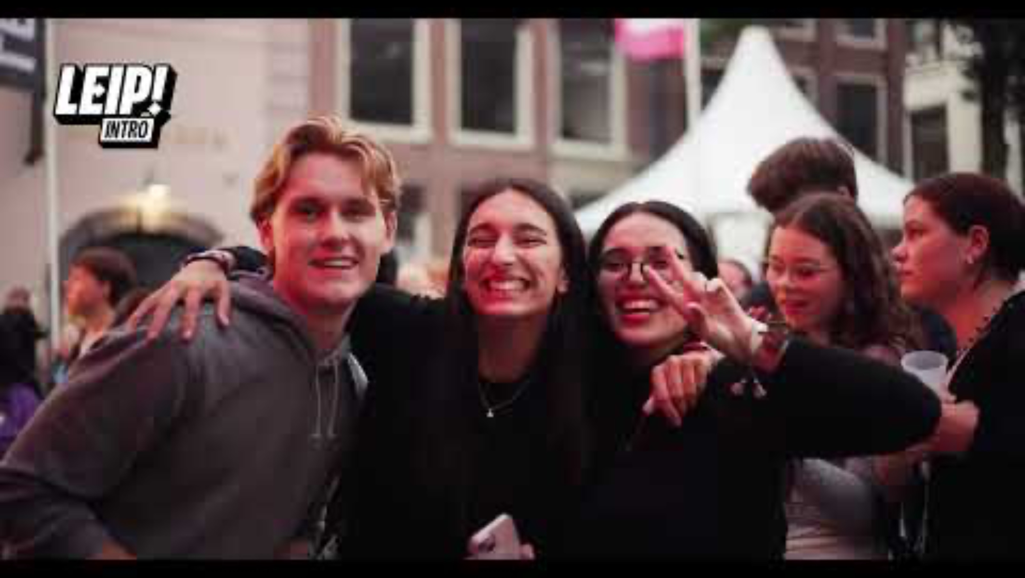

Slide 16

DISCOVER LEEUWARDEN & MAKE FRIENDS FOR LIFE
LEIP! INTRO 21 AUGUST – 24 AUGUST 2025
> The event where students — from vocational to PhD level — come together for an unforgettable introduction experience
LEIP! FESTIVAL 11 SEPTEMBER
> Kick-off your student life in style!
NEW LIL’LEIP! FESTIVAL – 6 MARCH
> Because we can!
Notes:
LEIP Intro Gedurende de introductiedagen maak je kennis met alles wat Leeuwarden te bieden heeft op het gebied van uitgaan, sport, muziek, eten en drinken. Laat je verrassen door de levendige cultuur, de gezellige cafés, de diverse culinaire scene en ontmoet je vrienden voor het leven.

Slide 17


Slide 18
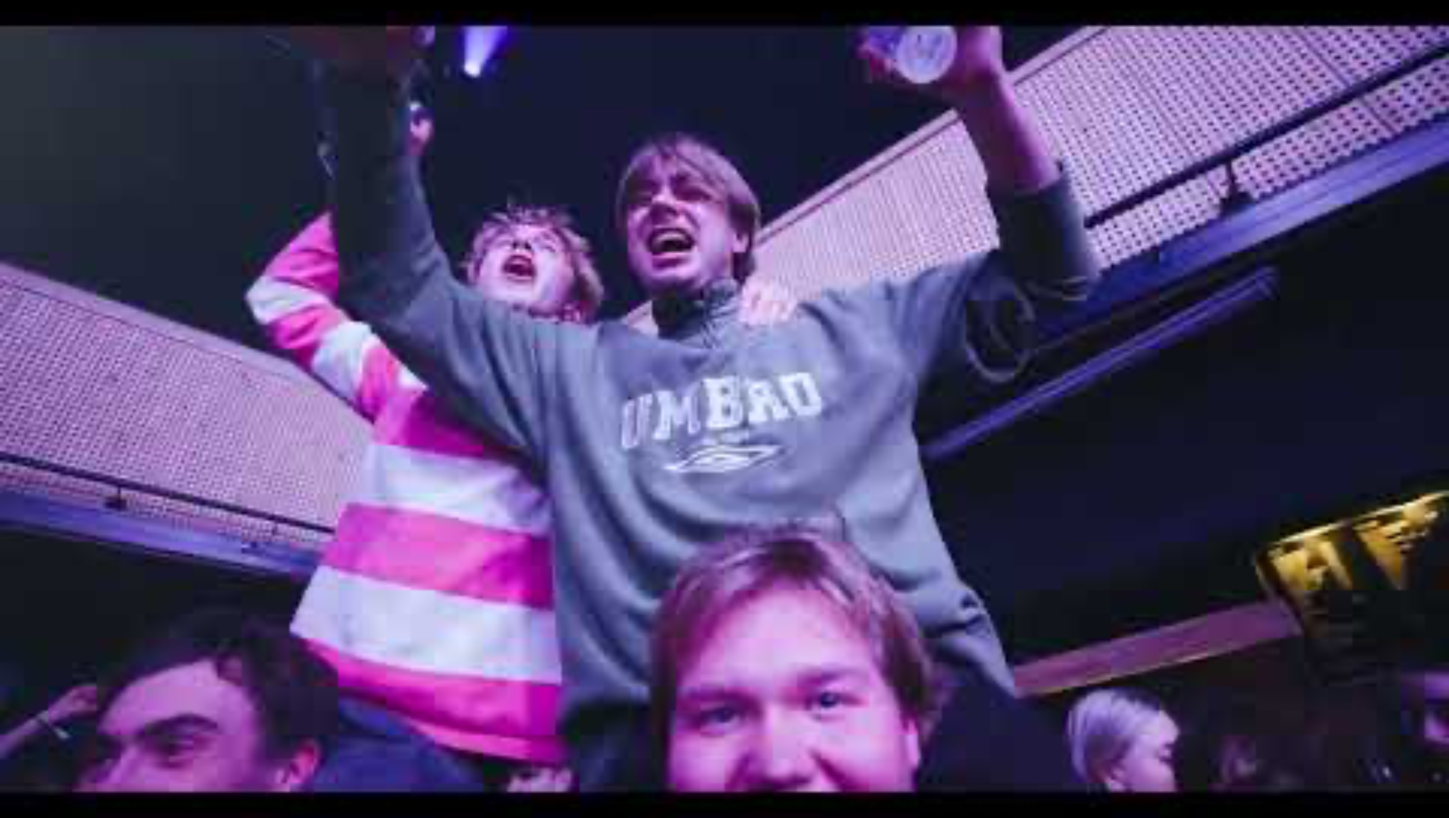

Slide 19

2025:
IF YOU CAN’T
BEAT THEM,
JOIN THEM.

Slide 20
WWW.LEEUWARDENSTUDENTCITY.NL
WWW.LEIP.NU
WWW.LEEUWARDENSTUDENTSPORT.NL

